Slide 1
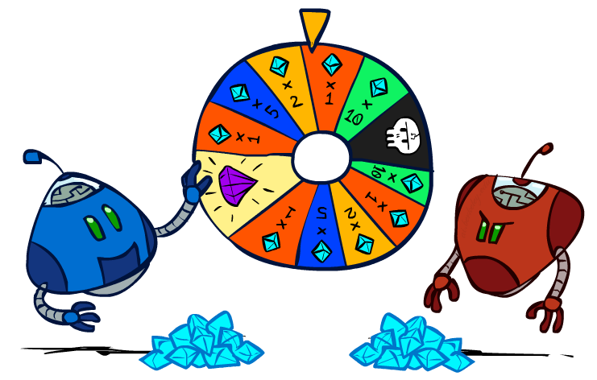
Artificial Intelligence
Adversarial Search with Uncertainty
CS 444 – Spring 2021
Dr. Kevin Molloy
Department of Computer Science
James Madison University
Much of this lecture is taken from
Dan Klein and Pieter Abbeel AI class at UC Berkeley

Slide 2
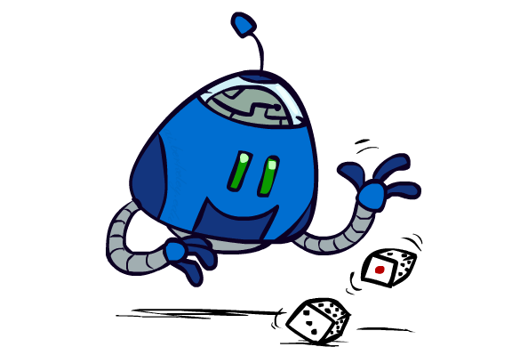
Today
Expand search to address games with uncertain outcomes.
Figure from Berkley AI

Slide 3
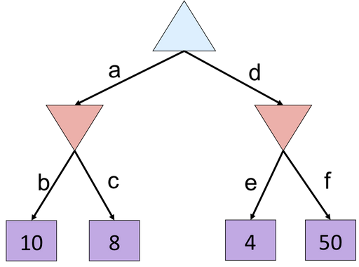
Alpha Beta Quiz
alpha= -np.inf
beta = np.inf
best_action = None
for a in game.actions(state):
v = min_value(game.result(state, a),alpha, beta)
if v > alpha:
alpha = v
best_action = a
return best_action
def max_value(state, alpha, beta):
if game.terminal_test(state):
return game.utility(state, player)
v = -np.inf
for a in game.actions(state):
v = max(v, min_value(game.result(state, a), alpha, beta))
if v >= beta:
return v
alpha = max(alpha, v)
return v
def min_value(state, alpha, beta):
if game.terminal_test(state):
return game.utility(state, player)
v = np.inf
for a in game.actions(state):
v = min(v, max_value(game.result(state, a), alpha, beta))
if v <= alpha:
return v
beta = min(beta, v)
return v
Figure from Berkley AI

Slide 4
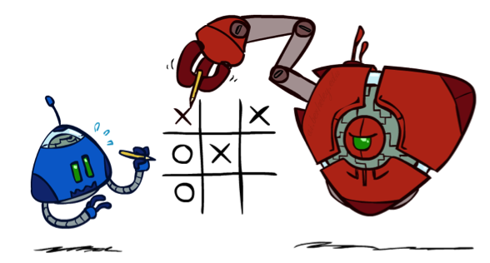

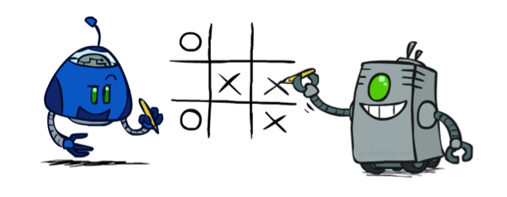
Worst-Case vs. Average Case
max
min
10
10
9
100
Idea: Uncertain outcomes controlled by chance, not an adversary!
Figure from Berkley AI

Slide 5
Expectimax Search
Why wouldn’t we know what the result of an action will be?
Explicit randomness: rolling dice
Unpredictable opponents: the ghosts respond randomly
Actions can fail: when moving a robot, wheels might slip
Values should now reflect average-case (expectimax) outcomes, not worst-case (minimax) outcomes
Expectimax search: compute the average score under optimal play
Max nodes as in minimax search
Chance nodes are like min nodes but the outcome is uncertain
Calculate their expected utilities
I.e. take weighted average (expectation) of children
Later, we’ll learn how to formalize the underlying uncertain-result problems as Markov Decision Processes
max
chance
10
10
4
10
5
9
7
100
Figure from Berkley AI

Slide 6
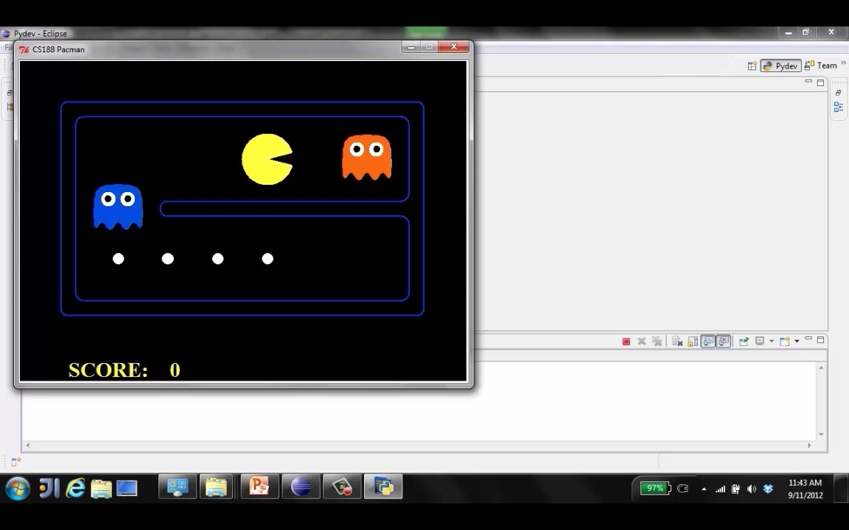
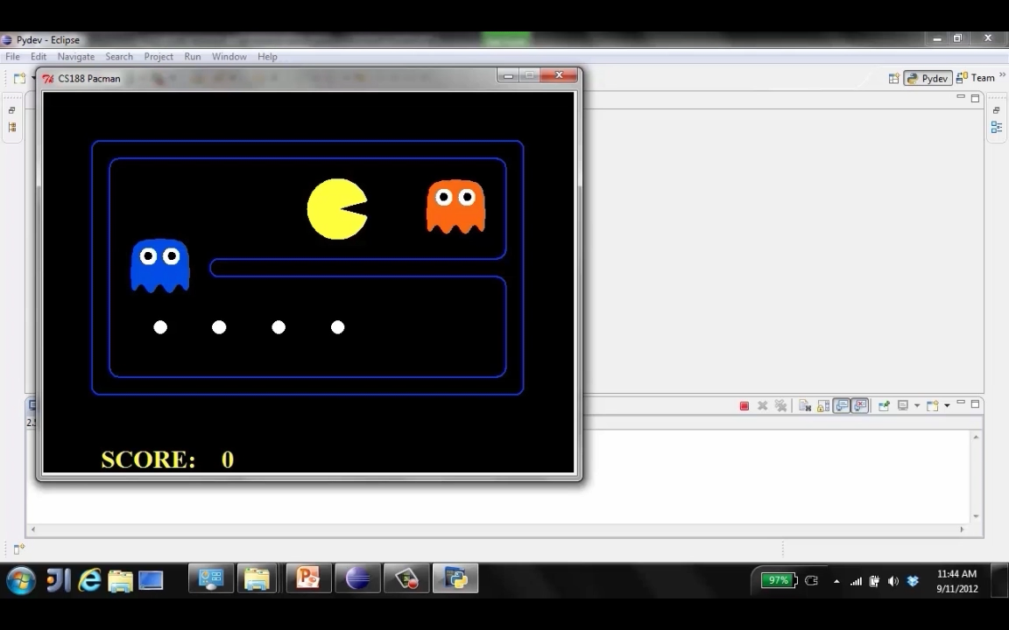
Video of Minimax vs Expectimax
Figure from Berkley AI

Slide 7
Expectimax Pseudocode
def value(state):
if the state is a terminal state: return the state’s utility
if the next agent is MAX: return max-value(state)
if the next agent is EXP: return exp-value(state)
def max-value(state):
initialize v = -∞
for each successor of state:
v = max(v, value(successor))
return v
def exp-value(state):
initialize v = 0
for each successor of state:
p = probability(successor)
v += p * value(successor)
return v
Figure from Berkley AI

Slide 8
Expectimax Pseudocode
def exp-value(state):
initialize v = 0
for each successor of state:
p = probability(successor)
v += p * value(successor)
return v
1/2
1/6
1/3
5
8
7
24
-12
v = (1/2) (8) + (1/3) (24) + (1/6) (-12) = 10
Figure from Berkley AI

Slide 9
Expectimax Example
3
12
9
2
4
6
15
6
0
Figure from Berkley AI

Slide 10
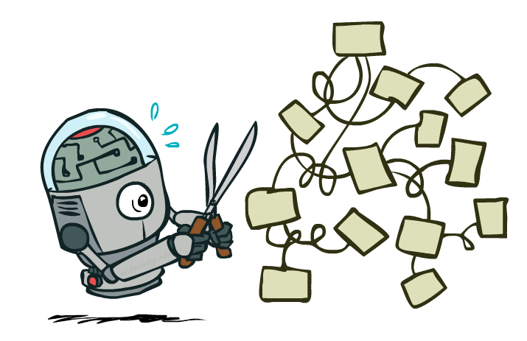
Expectimax Pruning?
3
12
9
2
Figure from Berkley AI

Slide 11



Depth-Limited Expectimax
Estimate of true expectimax value (which would require a lot of work to compute)
400
300
…
…
492
362
…
Figure from Berkley AI

Slide 12
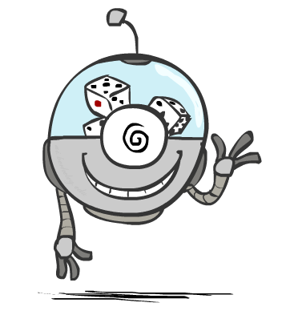
Probabilities
Figure from Berkley AI

Slide 13
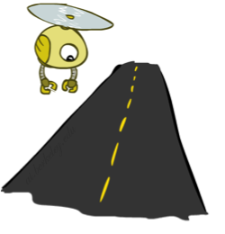
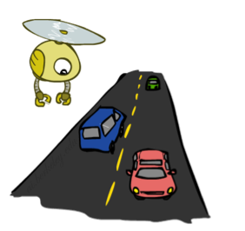
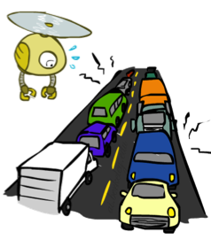
Probability Review
A random variable represents an event whose outcome is unknown
A probability distribution is an assignment of weights to outcomes
Example: Traffic on freeway
Random variable: T = whether there’s traffic
Outcomes: T in {none, light, heavy}
Distribution: P(T=none) = 0.25, P(T=light) = 0.50, P(T=heavy) = 0.25
Some laws of probability (more later):
Probabilities are always non-negative
Probabilities over all possible outcomes sum to one
As we get more evidence, probabilities may change:
P(T=heavy) = 0.25, P(T=heavy | Hour=8am) = 0.60
We’ll talk about methods for reasoning and updating probabilities later
0.25
0.50
0.25
Figure from Berkley AI

Slide 14
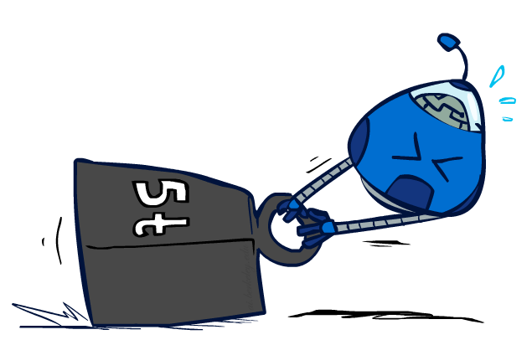
Expectations Review
The expected value of a function of a random variable is the average, weighted by the probability distribution over outcomes
Example: How long to get to the airport?
Time:
20 min
30 min
60 min
+
+
35 min
x
x
x
Probability:
0.25
0.50
0.25
Figure from Berkley AI

Slide 15

What Probabilities to Use?
In expectimax search, we have a probabilistic model of how the opponent (or environment) will behave in any state
Model could be a simple uniform distribution (roll a die)
Model could be sophisticated and require a great deal of computation
We have a chance node for any outcome out of our control: opponent or environment
The model might say that adversarial actions are likely!
For now, assume each chance node magically comes along with probabilities that specify the distribution over its outcomes
Having a probabilistic belief about another agent’s action does not mean that the agent is flipping any coins!
Figure from Berkley AI

Slide 16
Quiz: Informed Probabilities
Let’s say you know that your opponent is actually running a depth 2 minimax, using the result 80% of the time, and moving randomly otherwise
Question: What tree search should you use?
Answer: Expectimax!
To figure out EACH chance node’s probabilities, you have to run a simulation of your opponent
This kind of thing gets very slow very quickly
Even worse if you have to simulate your opponent simulating you…
… except for minimax, which has the nice property that it all collapses into one game tree
0.1 0.9
Figure from Berkley AI

Slide 17
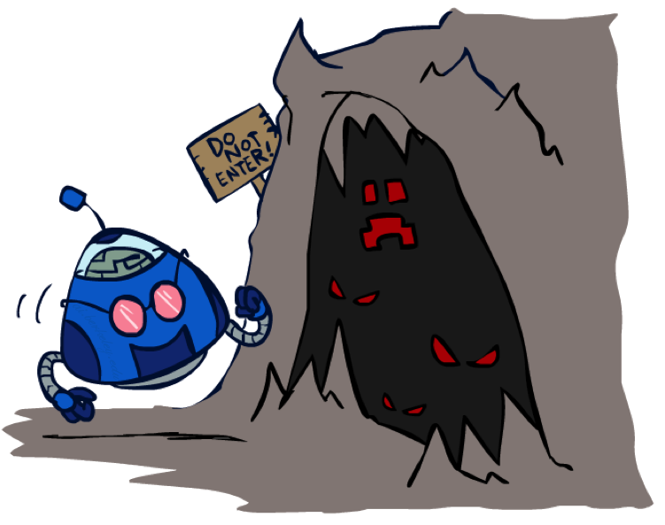
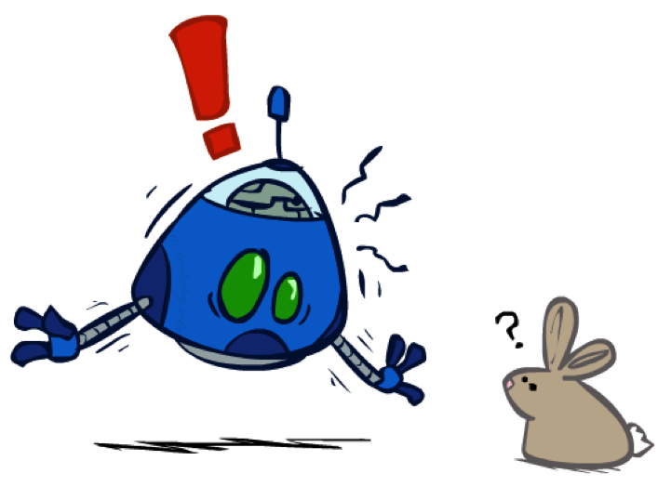
The Dangers of Optimism and Pessimism
Dangerous Optimism
Assuming chance when the world is adversarial
Dangerous Pessimism
Assuming the worst case when it’s not likely
Figure from Berkley AI

Slide 18
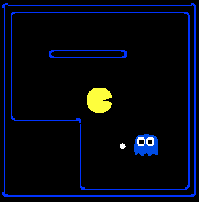
Assumptions vs. Reality
 | Adversarial Ghost | Random Ghost
Minimax Pacman
Expectimax Pacman
Pacman used depth 4 search with an eval function that avoids trouble Ghost used depth 2 search with an eval function that seeks Pacman
Figure from Berkley AI

Slide 19
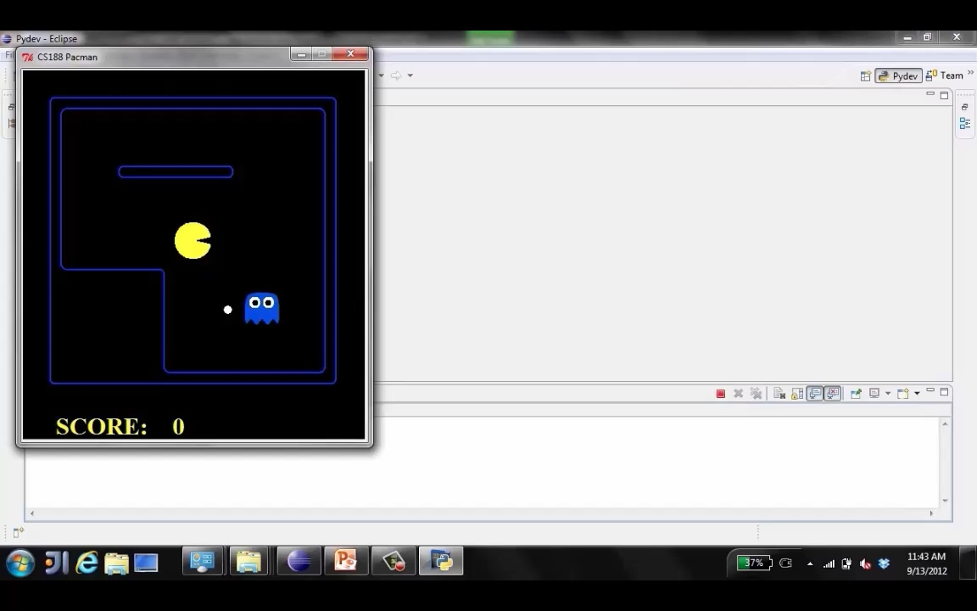
World Assumption Demo – Random Ghost Expectimax Pacman
Figure from Berkley AI

Slide 20
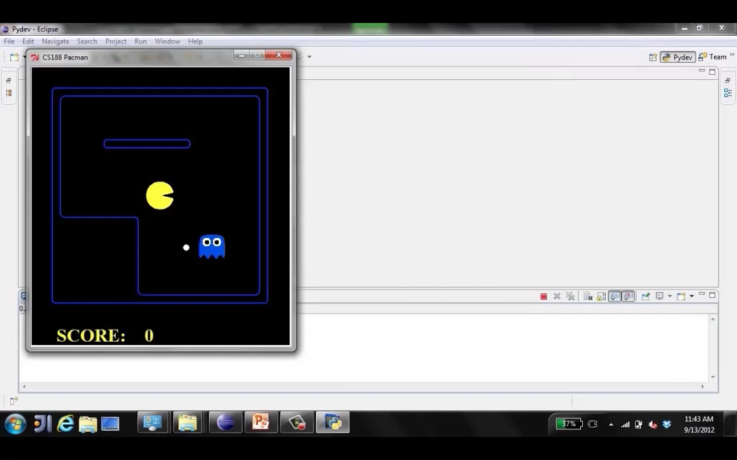
World Assumption Demo – Adversarial Ghost Minimax Pacman
Figure from Berkley AI

Slide 21
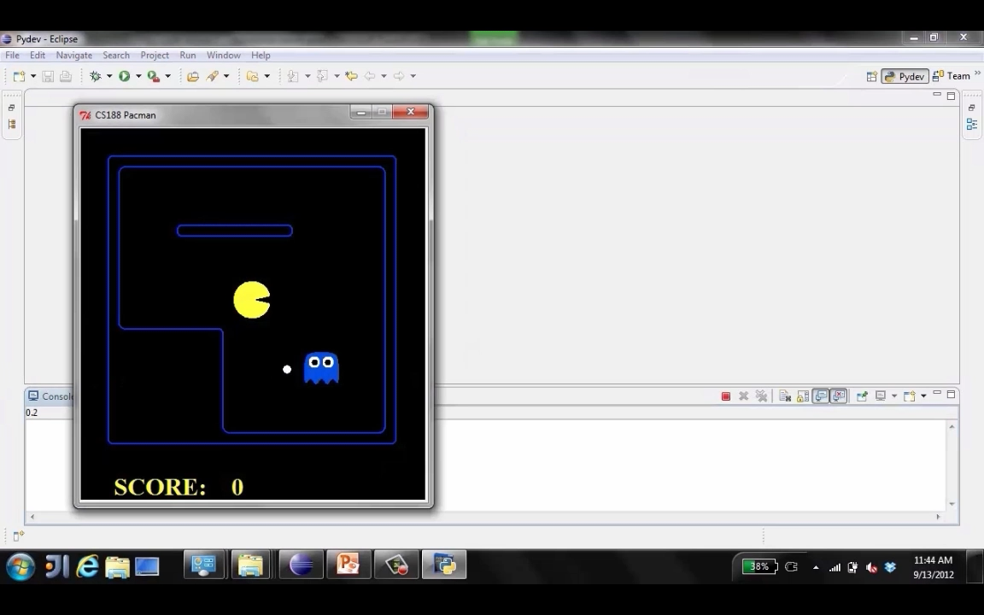
World Assumption Demo – Adversarial Ghost Expectimax Pacman
Figure from Berkley AI

Slide 22
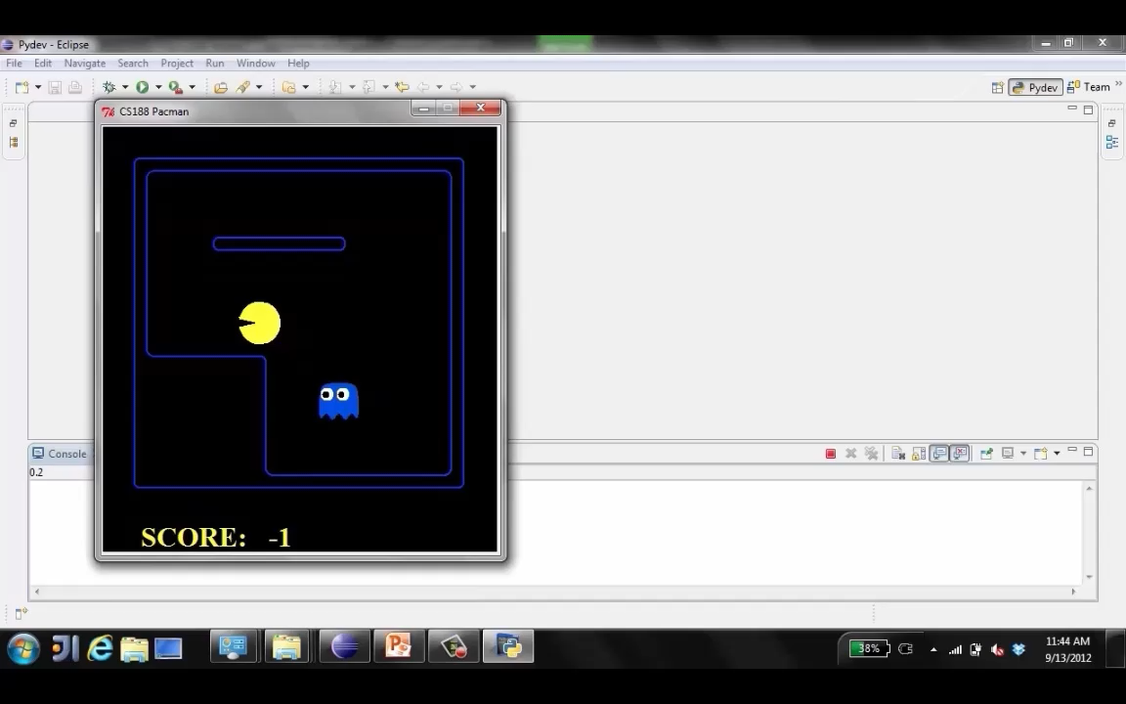
World Assumption Demo – Random Ghost Minimax Pacman
Figure from Berkley AI

Slide 23
Assumptions vs. Reality
 | Adversarial Ghost | Random Ghost
Minimax Pacman | Won 5/5 Avg. Score: 483 | Won 5/5 Avg. Score: 493
Expectimax Pacman | Won 1/5 Avg. Score: -303 | Won 5/5 Avg. Score: 503
Results from playing 5 games
Pacman used depth 4 search with an eval function that avoids trouble Ghost used depth 2 search with an eval function that seeks Pacman
Figure from Berkley AI

Slide 24
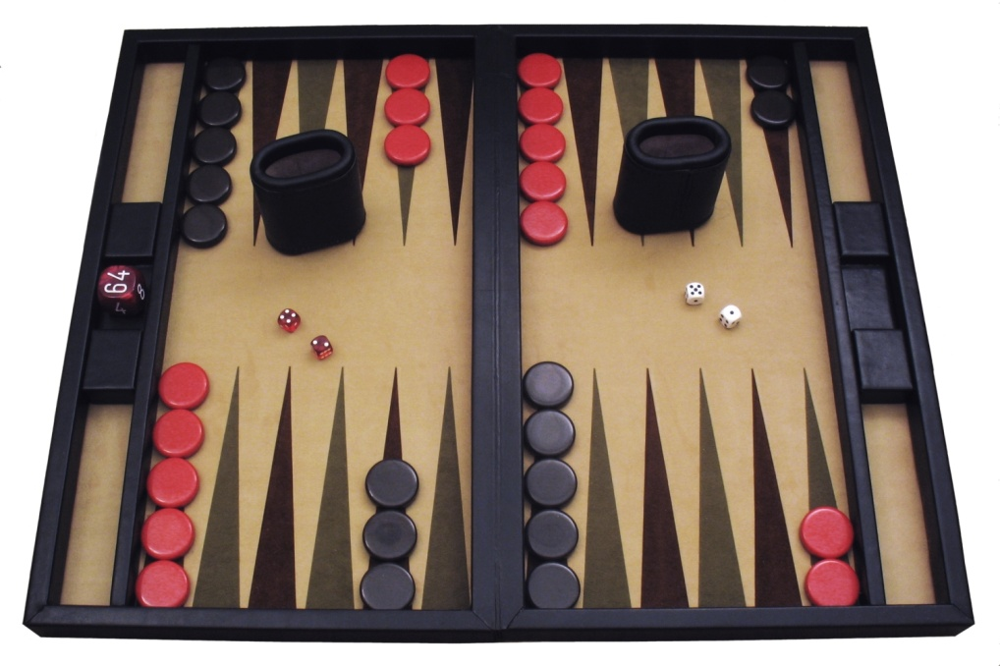
Example: Backgammon
Dice rolls increase b: 21 possible rolls with 2 dice
Backgammon ≈ 20 legal moves
Depth 2 = 20 x (21 x 20)³ = 1.2 x 10⁹
As depth increases, probability of reaching a given search node shrinks
So usefulness of search is diminished
So limiting depth is less damaging
But pruning is trickier…
Historic AI: TDGammon uses depth-2 search + very good evaluation function + reinforcement learning: world-champion level play
1st AI world champion in any game!
Image: Wikipedia
Figure from Berkley AI

Slide 25
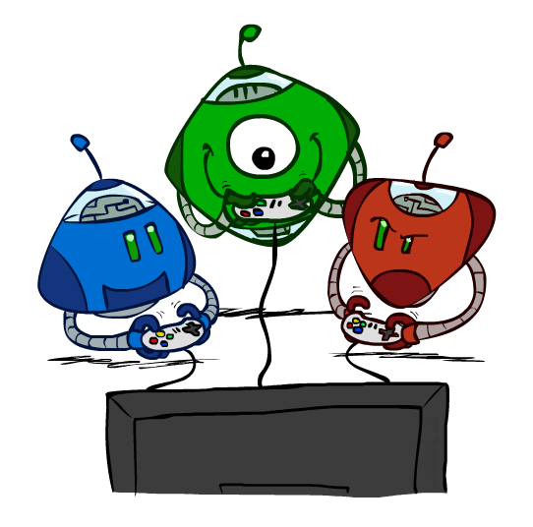
Other Game Types
Figure from Berkley AI

Slide 26



Mixed Layer Types
E.g. Backgammon
Expectiminimax
Environment is an extra “random agent” player that moves after each min/max agent
Each node computes the appropriate combination of its children
Figure from Berkley AI

Slide 27
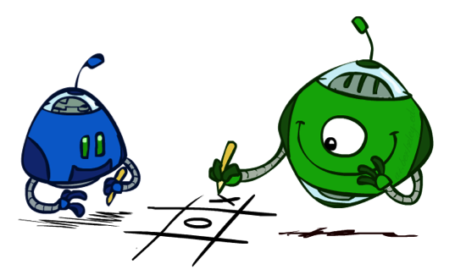
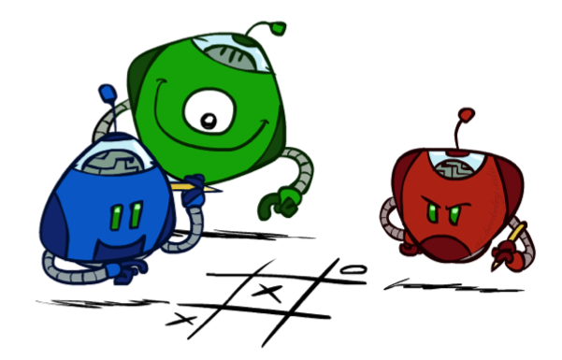
Multi-Agent Utilities
What if the game is not zero-sum, or has multiple players?
Generalization of minimax:
Terminals have utility tuples
Node values are also utility tuples
Each player maximizes its own component
Can give rise to cooperation and
competition dynamically…
1,6,6
7,1,2
6,1,2
7,2,1
5,1,7
1,5,2
7,7,1
5,2,5
Figure from Berkley AI

Slide 28
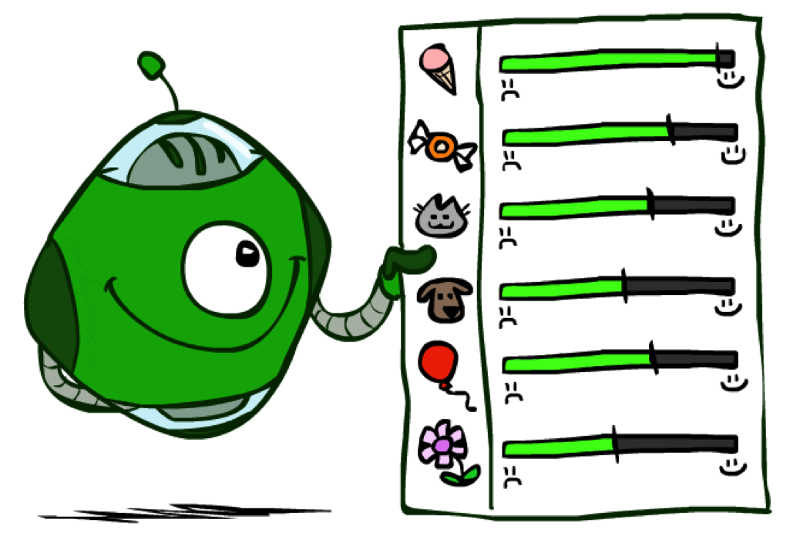
Utilities
Figure from Berkley AI

Slide 29

Maximum Expected Utility
Why should we average utilities? Why not minimax?
Principle of maximum expected utility:
A rational agent should chose the action that maximizes its expected utility, given its knowledge
Questions:
Where do utilities come from?
How do we know such utilities even exist?
How do we know that averaging even makes sense?
What if our behavior (preferences) can’t be described by utilities?
Figure from Berkley AI

Slide 30
What Utilities to Use?
0
40
20
30
x²
0
1600
400
900
For worst-case minimax reasoning, terminal function scale doesn’t matter
We just want better states to have higher evaluations (get the ordering right)
We call this insensitivity to monotonic transformations
For average-case expectimax reasoning, we need magnitudes to be meaningful
Figure from Berkley AI

Slide 31

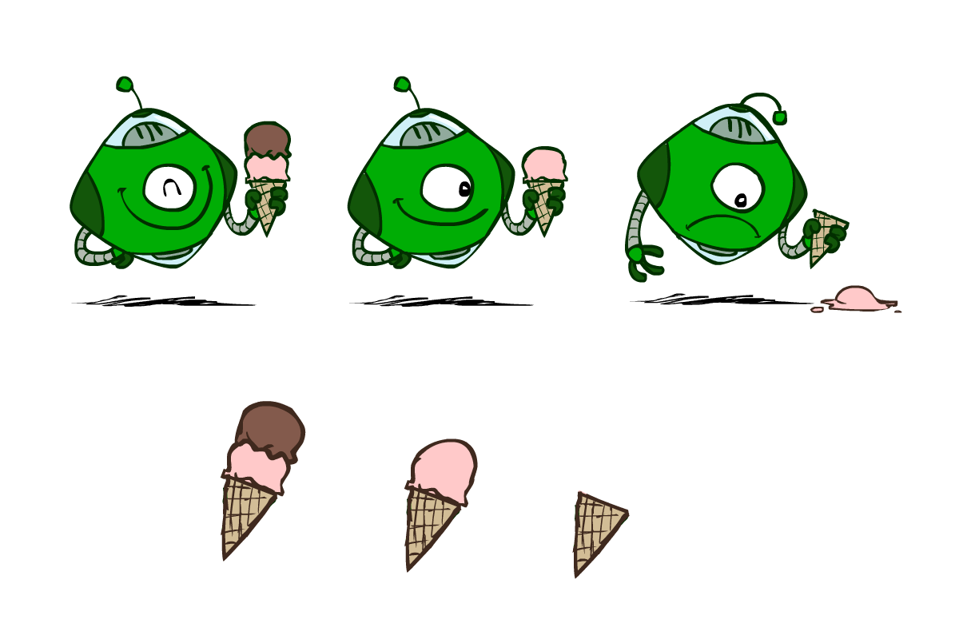
Utilities
Utilities are functions from outcomes (states of the world) to real numbers that describe an agent’s preferences
Where do utilities come from?
In a game, may be simple (+1/-1)
Utilities summarize the agent’s goals
Theorem: any “rational” preferences can be summarized as a utility function
We hard-wire utilities and let behaviors emerge
Why don’t we let agents pick utilities?
Why don’t we prescribe behaviors?
Figure from Berkley AI

Slide 32
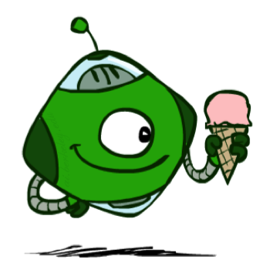
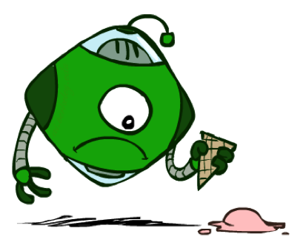
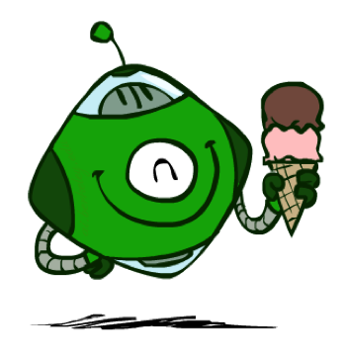
Utilities: Uncertain Outcomes
Getting ice cream
Get Single
Get Double
Oops
Whew!
Figure from Berkley AI

Slide 33
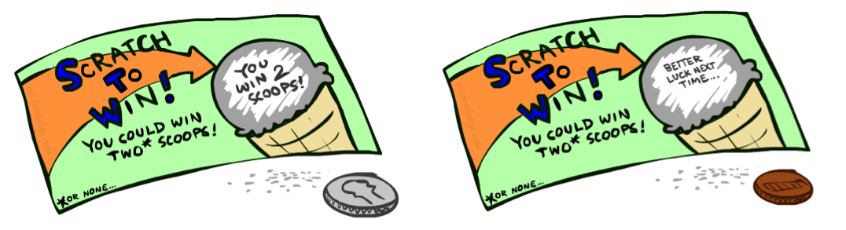
Preferences
A Prize
A Lottery
An agent must have preferences among:
Prizes: A, B, etc.
Lotteries: situations with uncertain prizes
Notation:
Preference:
Indifference:
A
p 1-p
A B
Figure from Berkley AI

Slide 34
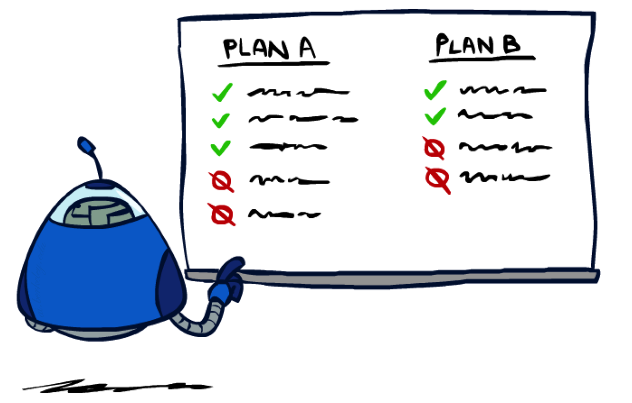
Rationality
Figure from Berkley AI

Slide 35
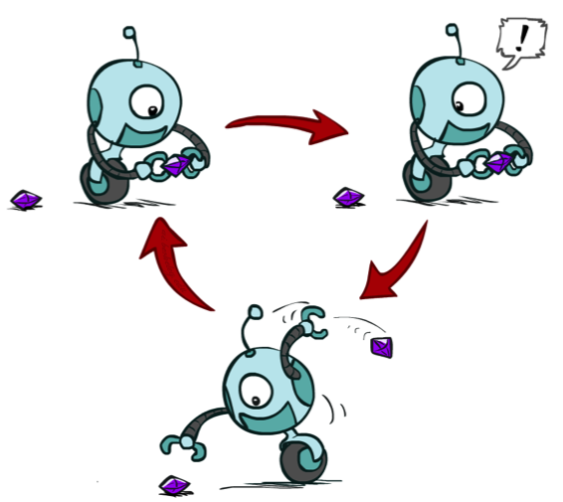
Rational Preferences
We want some constraints on preferences before we call them rational, such as:
For example: an agent with intransitive preferences can
be induced to give away all of its money
If B > C, then an agent with C would pay (say) 1 cent to get B
If A > B, then an agent with B would pay (say) 1 cent to get A
If C > A, then an agent with A would pay (say) 1 cent to get C
Axiom of Transitivity:
Figure from Berkley AI

Slide 36

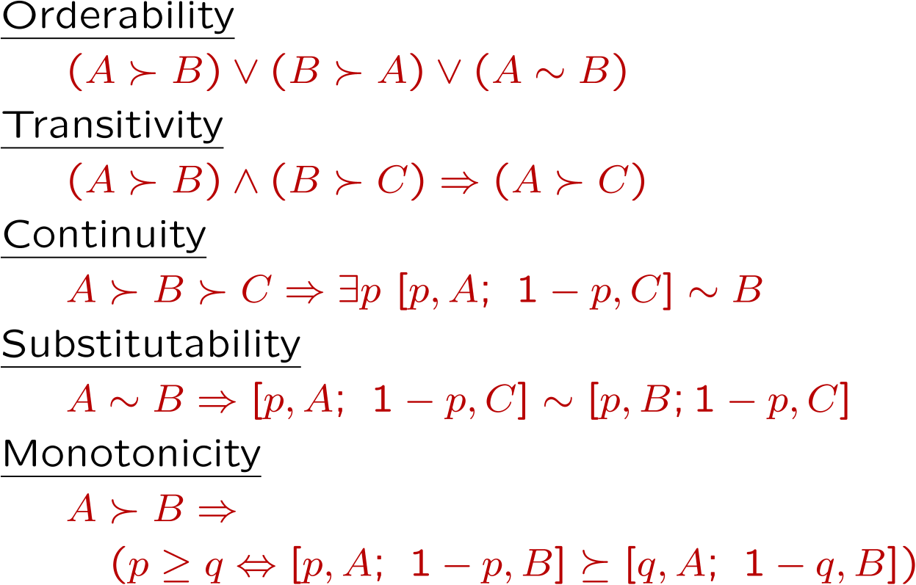
Rational Preferences
The Axioms of Rationality
Theorem: Rational preferences imply behavior describable as maximization of expected utility
Figure from Berkley AI

Slide 37
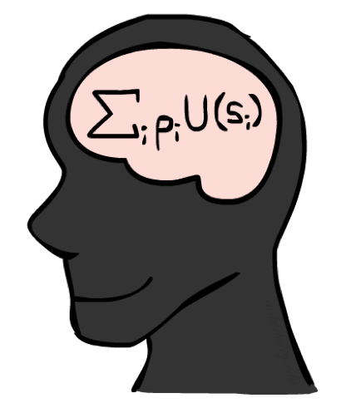
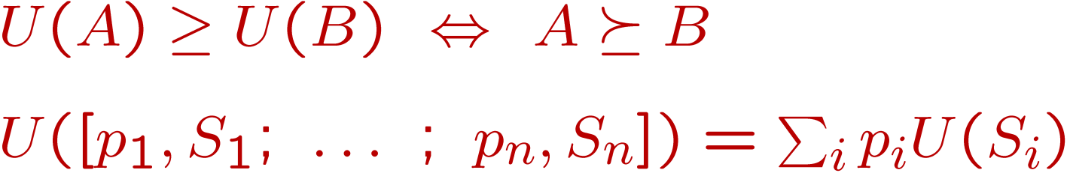
MEU Principle
Theorem [Ramsey, 1931; von Neumann & Morgenstern, 1944]
Given any preferences satisfying these constraints, there exists a real-valued
function U such that:
I.e. values assigned by U preserve preferences of both prizes and lotteries!
Maximum expected utility (MEU) principle:
Choose the action that maximizes expected utility
Note: an agent can be entirely rational (consistent with MEU) without ever representing or manipulating utilities and probabilities
E.g., a lookup table for perfect tic-tac-toe, a reflex vacuum cleaner
Figure from Berkley AI

Slide 38
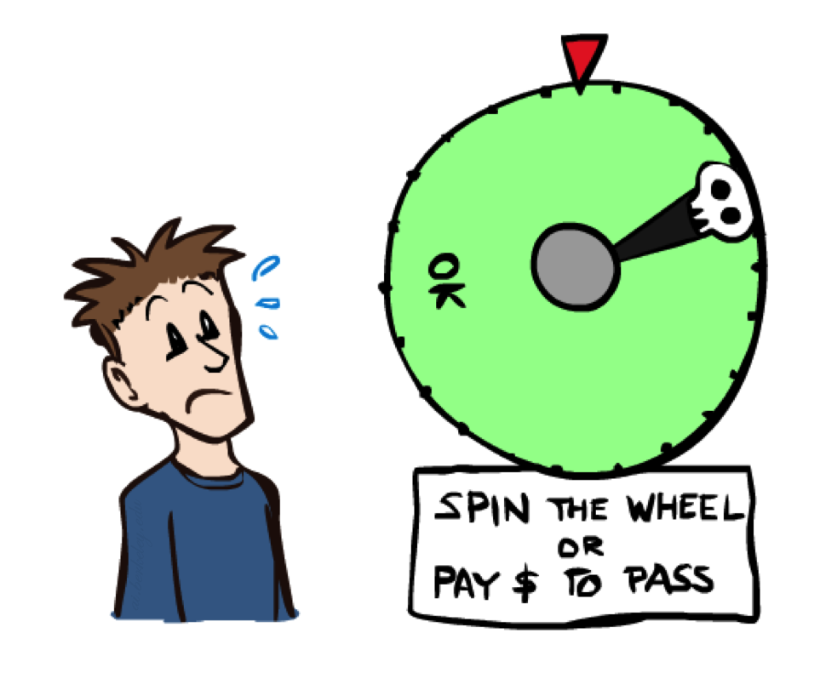
Human Utilities
Figure from Berkley AI

Slide 39

Utility Scales
Normalized utilities: u₊ = 1.0, u₋ = 0.0
Micromorts: one-millionth chance of death, useful for paying to reduce product risks, etc.
QALYs: quality-adjusted life years, useful for medical decisions involving substantial risk
Note: behavior is invariant under positive linear transformation
With deterministic prizes only (no lottery choices), only ordinal utility can be determined, i.e., total order on prizes
Figure from Berkley AI

Slide 40


Human Utilities
Utilities map states to real numbers. Which numbers?
Standard approach to assessment (elicitation) of human utilities:
Compare a prize A to a standard lottery L_{p} between
“best possible prize” u₊ with probability p
“worst possible catastrophe” u₋ with probability 1-p
Adjust lottery probability p until indifference: A ~ L_{p}
Resulting p is a utility in [0,1]
Pay $30
0.999999 0.000001
No change
Instant death
Figure from Berkley AI

Slide 41
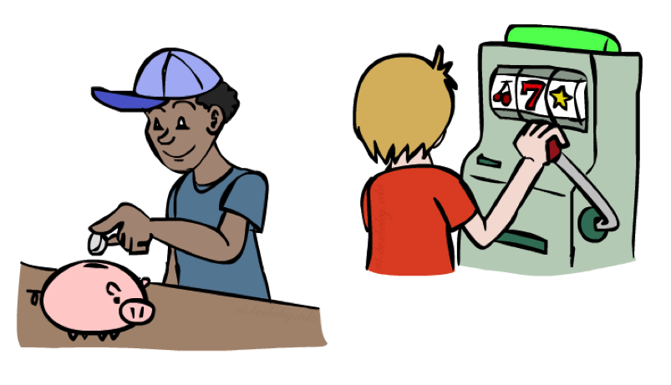
Money
Money does not behave as a utility function, but we can talk about the utility of having money (or being in debt)
Given a lottery L = [p, $X; (1-p), $Y]
The expected monetary value EMV(L) is p*X + (1-p)*Y
U(L) = p*U($X) + (1-p)*U($Y)
Typically, U(L) < U( EMV(L) )
In this sense, people are risk-averse
When deep in debt, people are risk-prone
Figure from Berkley AI

Slide 42
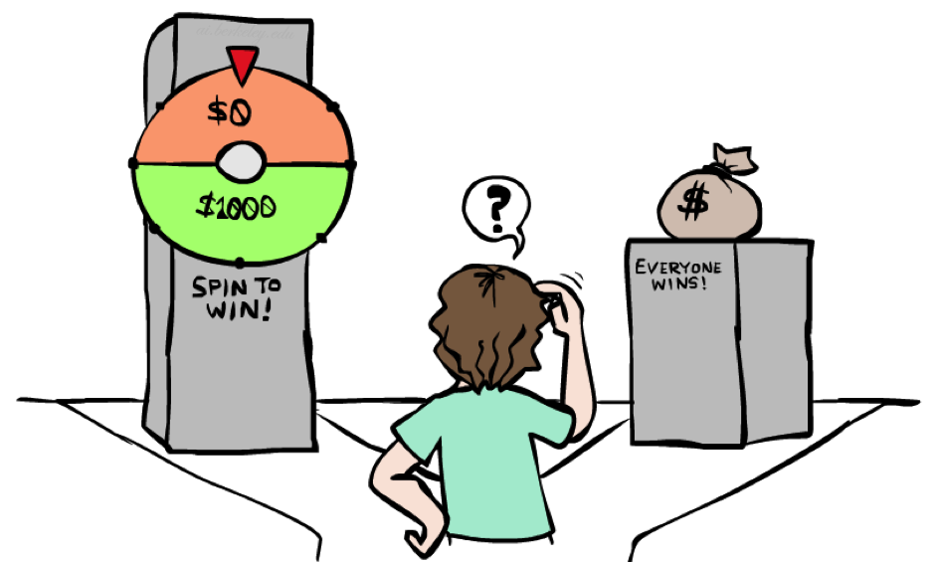
Example: Insurance
Consider the lottery [0.5, $1000; 0.5, $0]
What is its expected monetary value? ($500)
What is its certainty equivalent?
Monetary value acceptable in lieu of lottery
$400 for most people
Difference of $100 is the insurance premium
There’s an insurance industry because people will pay to reduce their risk
If everyone were risk-neutral, no insurance needed!
It’s win-win: you’d rather have the $400 and the insurance company would rather have the lottery (their utility curve is flat and they have many lotteries)
Figure from Berkley AI

Slide 43

Example: Human Rationality?
Famous example of Allais (1953)
A: [0.8, $4k; 0.2, $0]
B: [1.0, $3k; 0.0, $0]
C: [0.2, $4k; 0.8, $0]
D: [0.25, $3k; 0.75, $0]
Most people prefer B > A, C > D
But if U($0) = 0, then
B > A ⇒ U($3k) > 0.8 U($4k)
C > D ⇒ 0.8 U($4k) > U($3k)
Figure from Berkley AI

Slide 44
Next Time
Quiz 1b and Quiz 2 Release tomorrow. Due Monday
PA 2 Due next Friday
Next time we will start discussion Markov Decision Processes (MDPs)
Figure from Berkley AI

